Slide 1
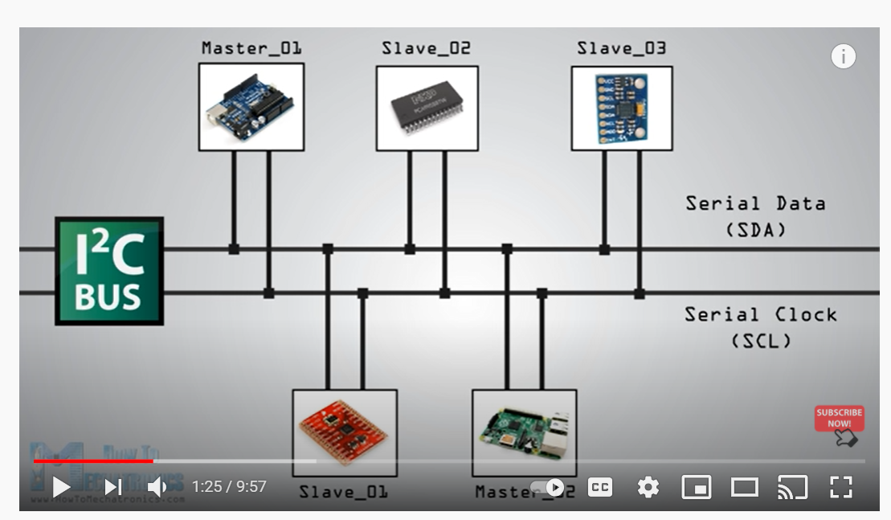
Make a diagram like:
https://youtu.be/6IAkYpmA1DQ
Notes:
https://youtu.be/6IAkYpmA1DQ
How I2C Communication Works and How To Use It with Arduino
How to Mechatronics

Slide 2
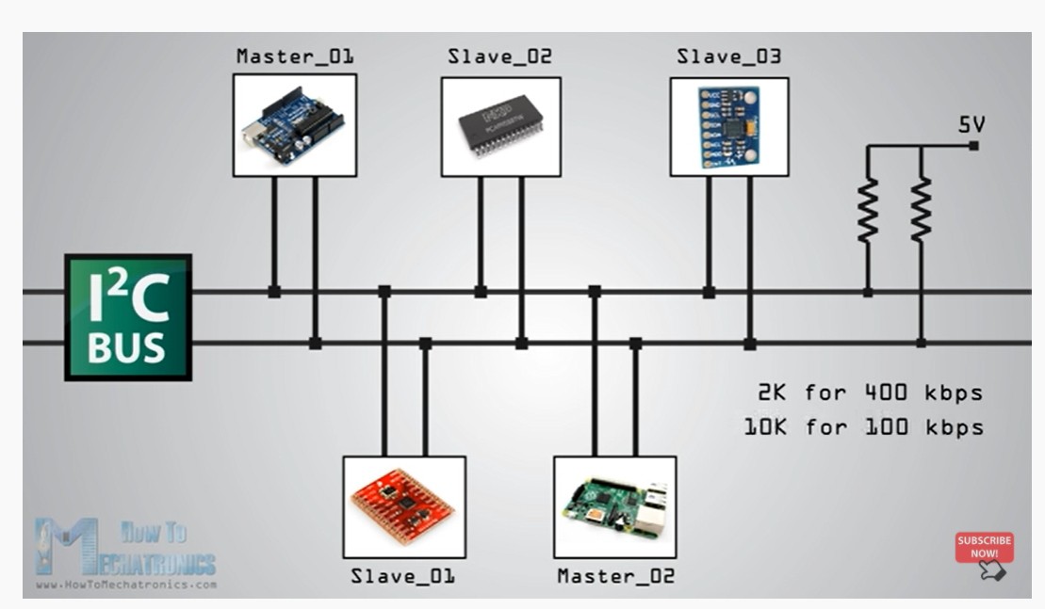
Notes:
https://youtu.be/6IAkYpmA1DQ?t=116

Slide 3
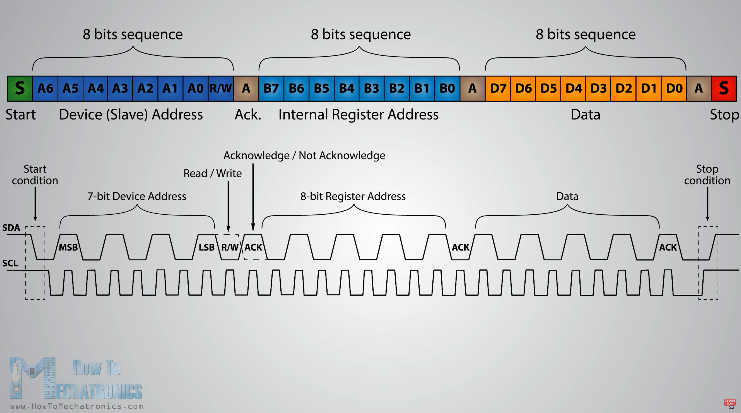

Slide 4
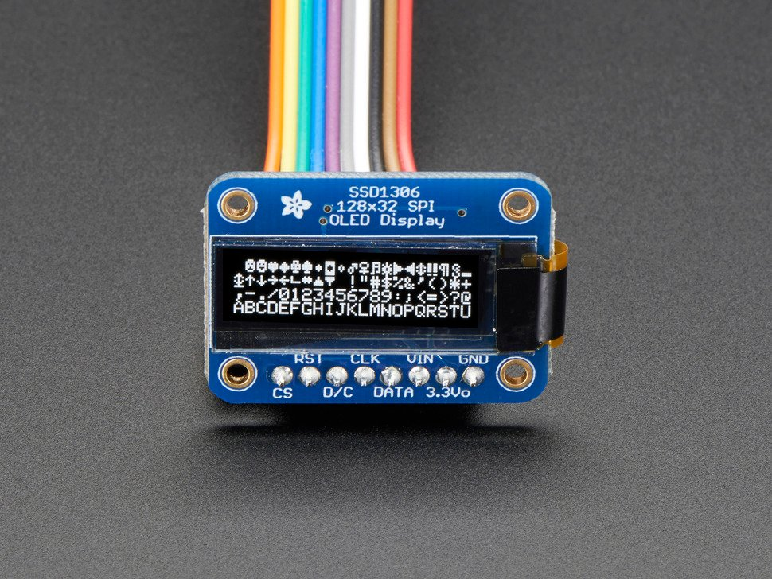
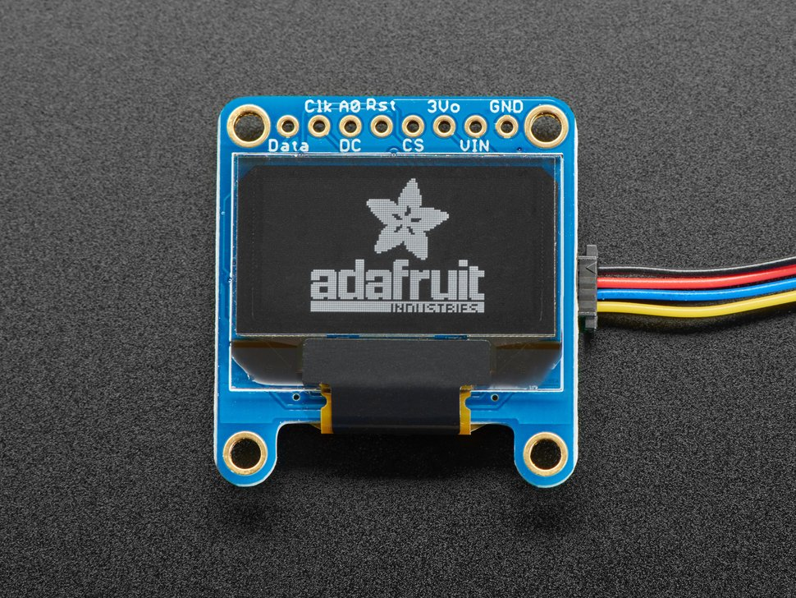
Monochrome 128x32 SPI OLED graphic display
https://www.adafruit.com/product/661
Monochrome 0.96" 128x64 OLED Graphic Display - STEMMA QT
https://www.adafruit.com/product/326

Slide 5
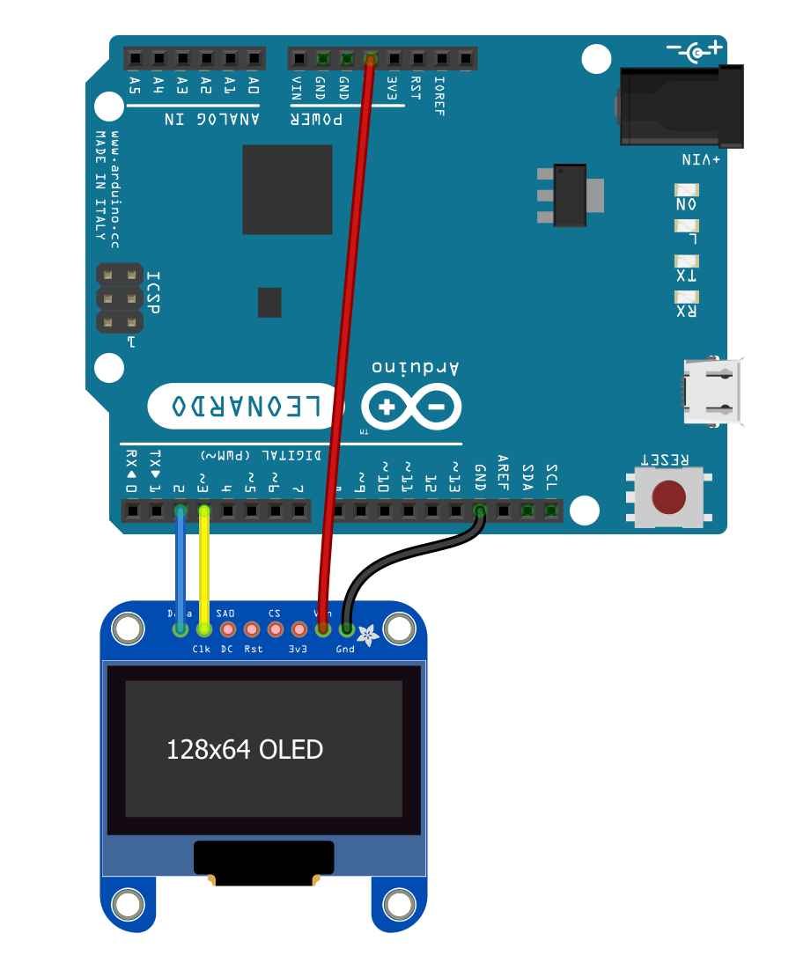
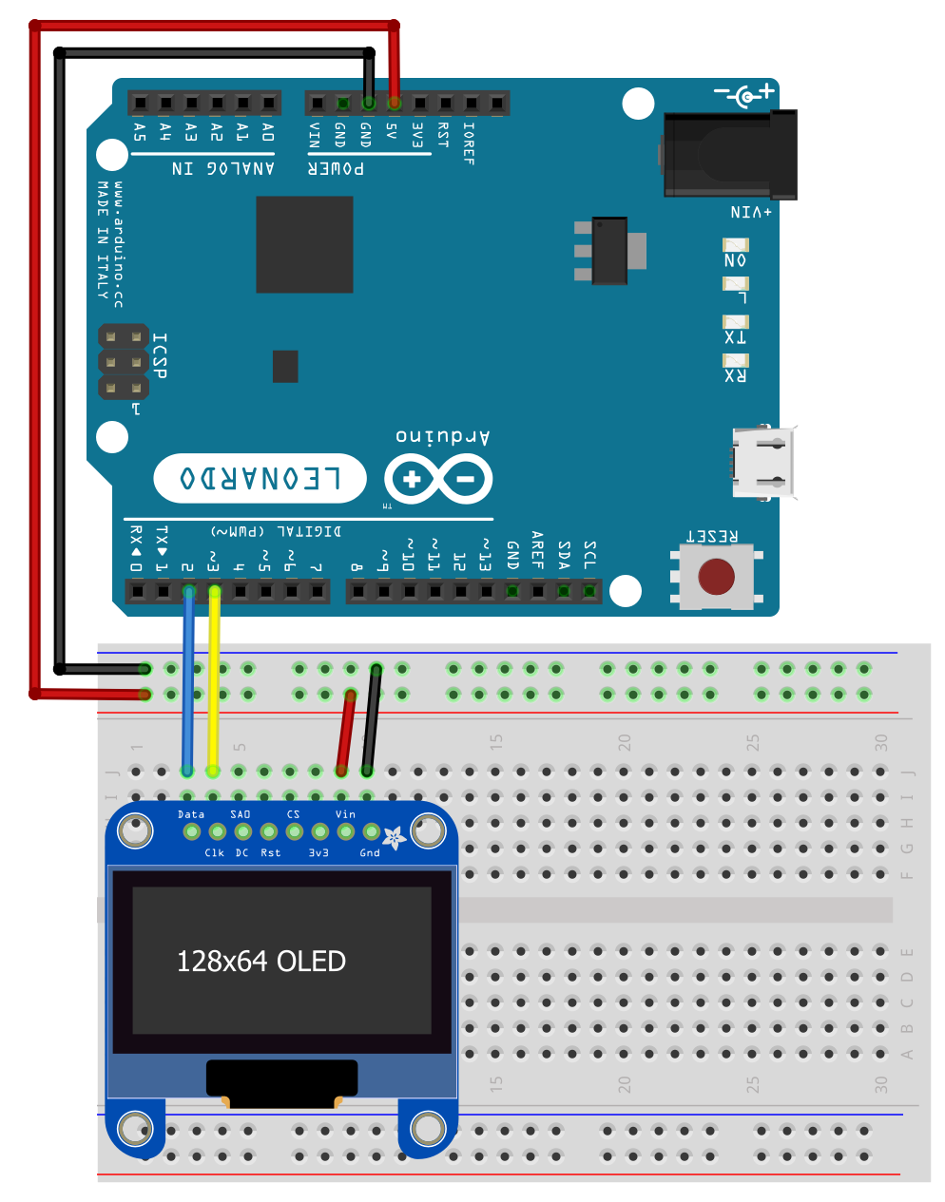
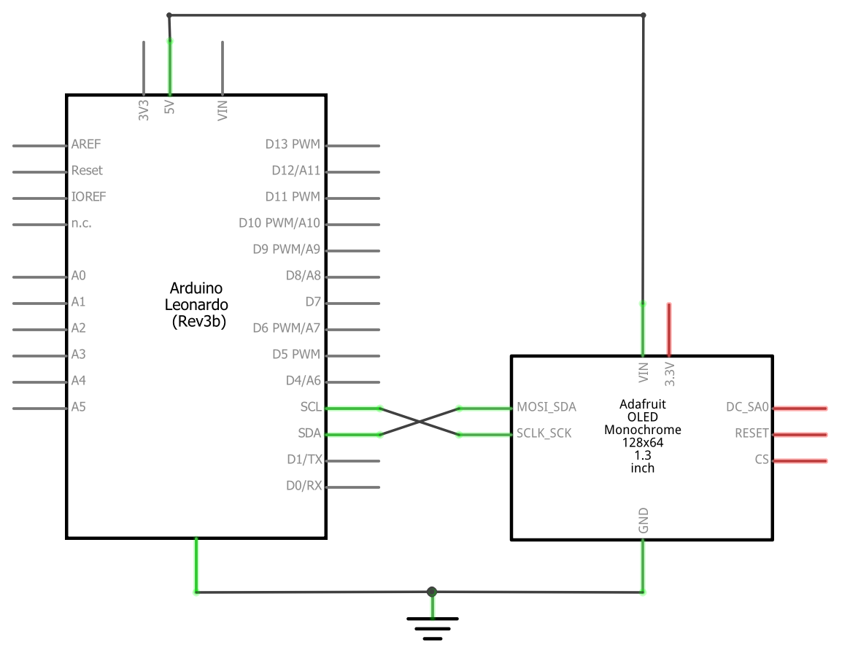
OLED Wiring (No Breadboard)
OLED Wiring (with Breadboard)
OLED Wiring (schematic)

Slide 6
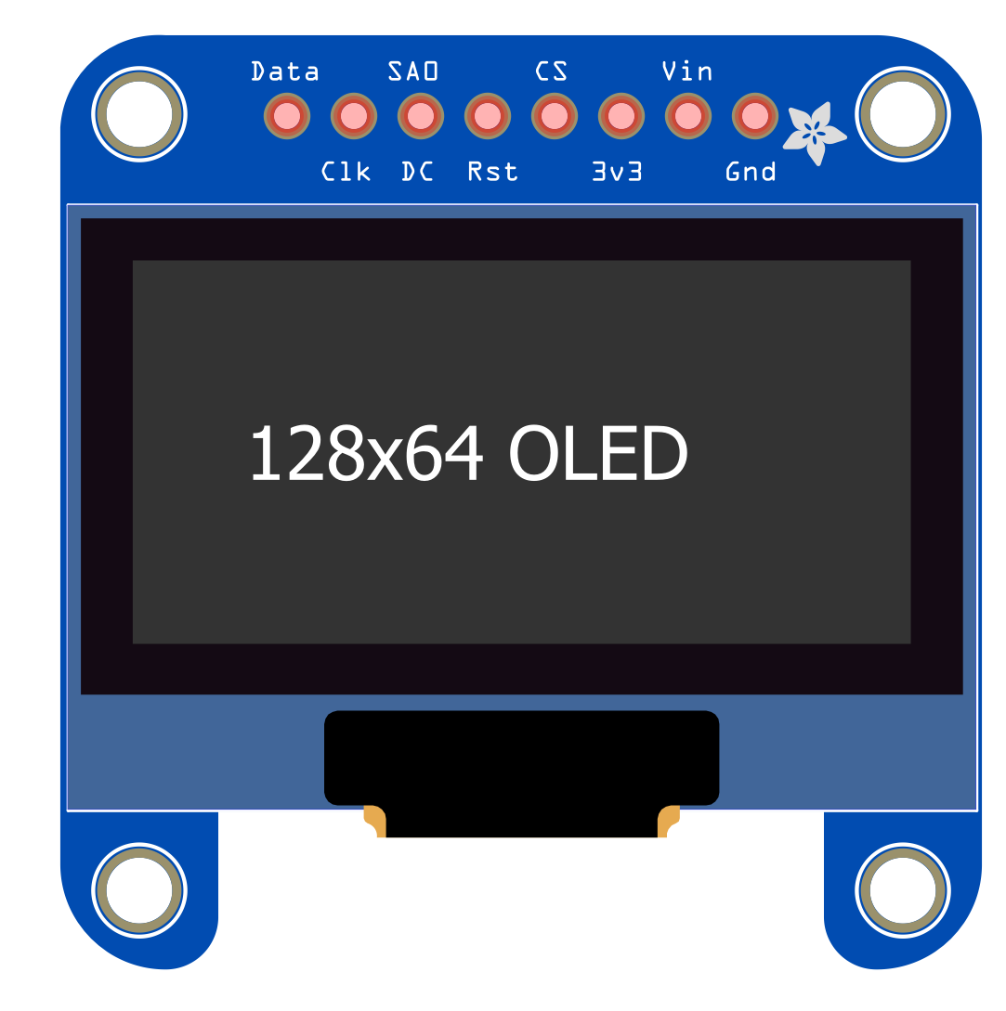
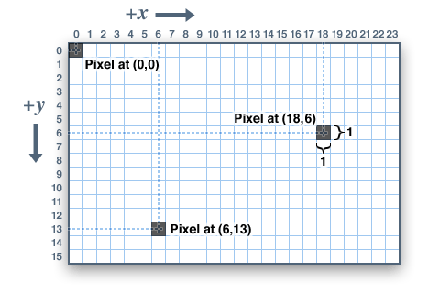
128 pixels
64 pixels

Slide 7
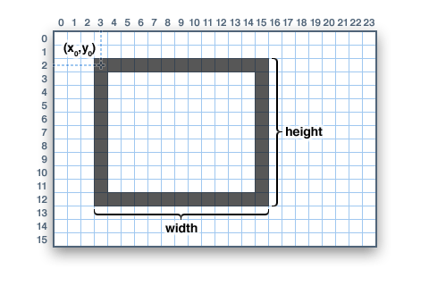

Slide 8
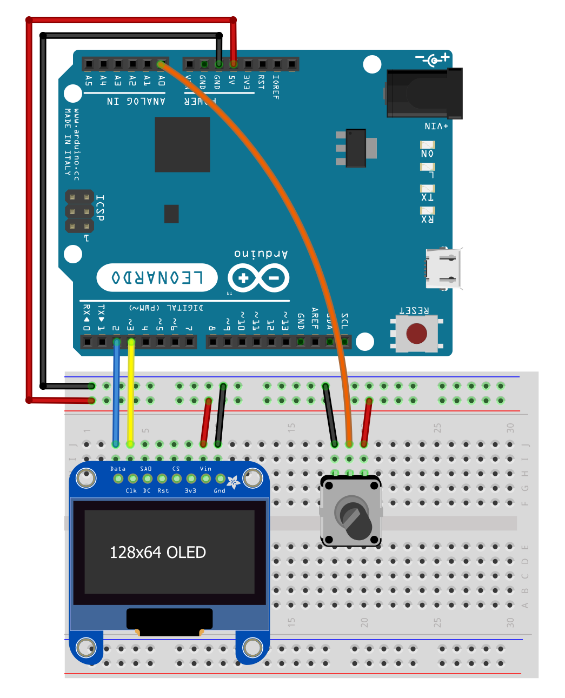
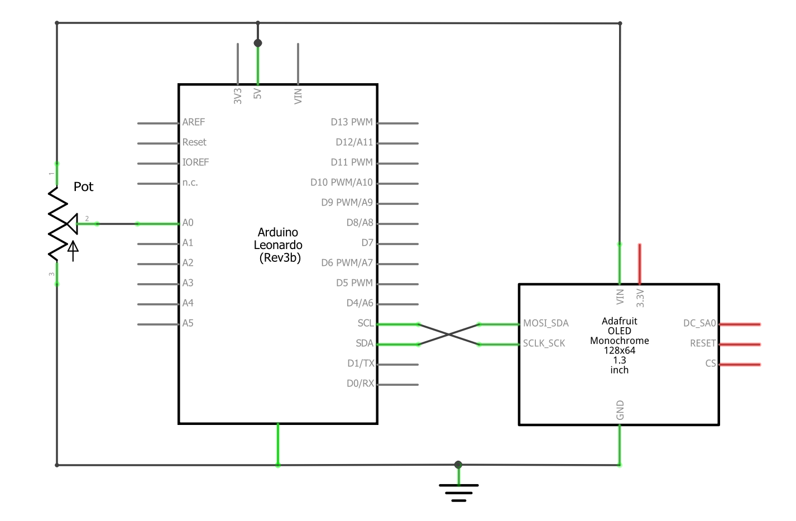

Slide 9
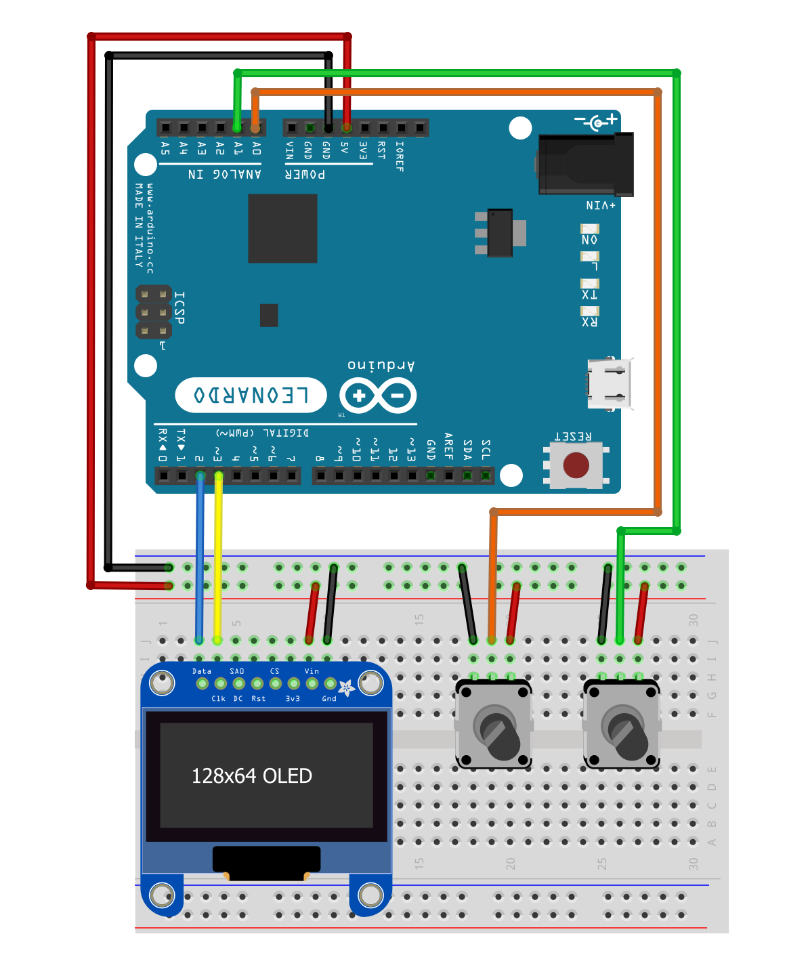
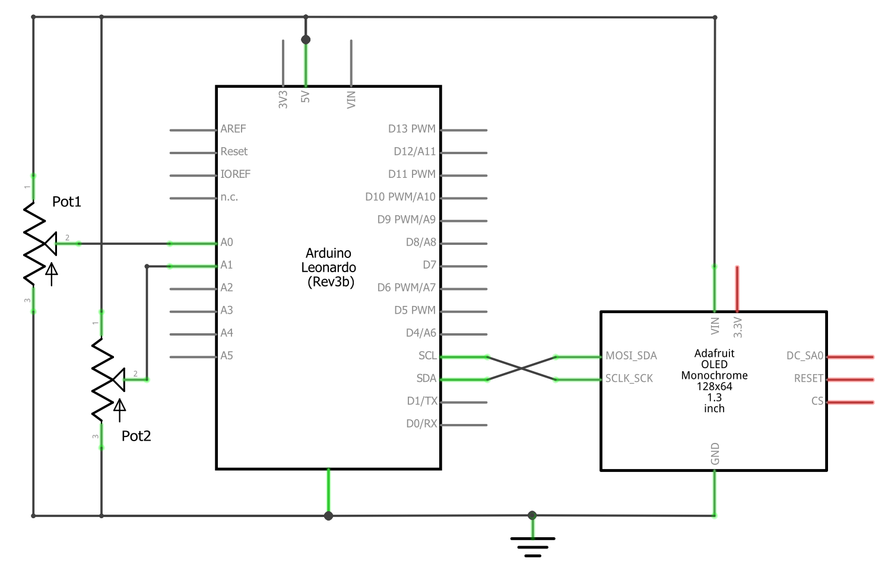

Slide 10
